Slide 1
L03 - Software Technologies
Dictionary
  “techno-” art, skill, craft
  “-logy” method, system
© 2012 Václav Rajlich, with addition from D. Hou Software Engineering: The Current Practice Ch. 3

Slide 2
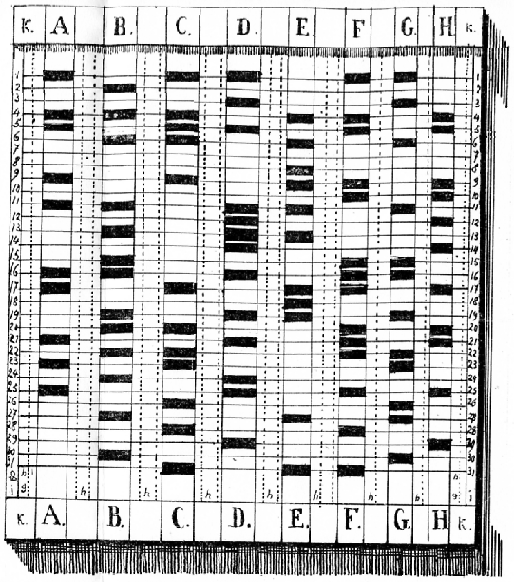
History
Historically, SE changed not only the paradigms, but also technologies
Fortran II + punched cards
  technology of the past (IBM 704)
Swing/Java
  JavaScript+HTML+WebServer+DB
  technology of the present
Services oriented architectures (SOA)
  possible technology of the future
Notes:
See wikipedia page for punched card, joke
Fortran II
http://www.softwarepreservation.org/projects/FORTRAN/

Slide 3
Technology success
Does it address important issue?
Is research and development completed?
Are market forces behind the technology?
Only then, other measures may play a role
    productivity, usability, other properties

Slide 4
Technology issues
Locked-in effect:
  Reengineering from one technology to another is often hard
Technology and culture
  technology can be dead for cultural reasons.

Slide 5
Software technology portfolio
Programming languages and compilers
Software environments
  programmer activities
  tools
Version Control System
Testing technologies
Libraries and API’s: GUI, Databases
. . .

Slide 6
Object oriented technology
Classes
Objects
class Customer {
// methods
public open_account();
public deposit(int deposit_amount);
public withdraw(int withdrawal_amount);
// attributes
protected String name;
protected String address;
protected int account_number;
protected int balance = 0;
}
Customer jacob, joseph;
© 2012 Václav Rajlich Software Engineering: The Current Practice Ch. 3

Slide 7
OO code
Customer jacob, joseph;
jacob.open_account();
jacob.deposit(100);
jacob.withdraw(10);
© 2012 Václav Rajlich Software Engineering: The Current Practice Ch. 3

Slide 8
Coding conventions
CamelCase
  firstCustomerWithdrawal
Under_line
  first_customer_withdrawal
© 2012 Václav Rajlich Software Engineering: The Current Practice Ch. 3

Slide 9
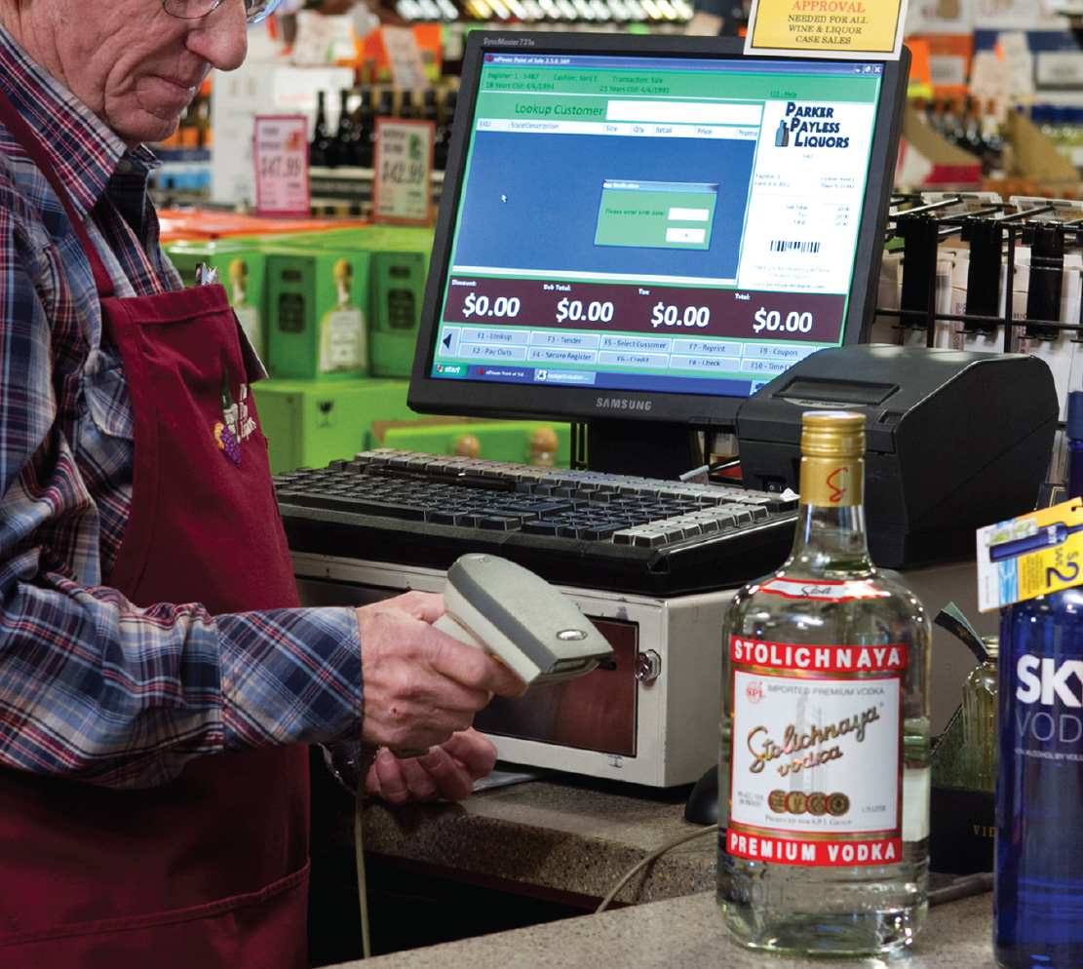
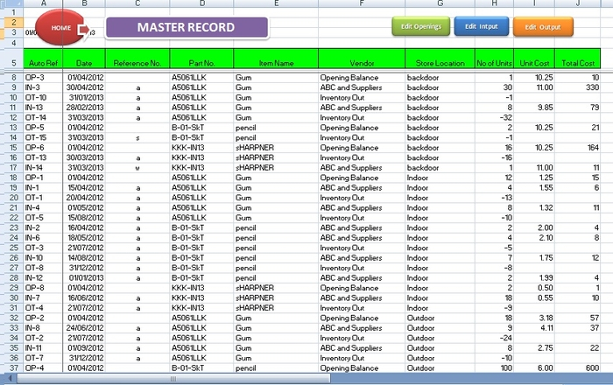
Part-of relationship
Component
  inventory and register are parts of a store
  components of a store
  class Store
  {
  protected Inventory inv;
  protected Register reg;
  }
© 2012 Václav Rajlich, D. Hou Software Engineering: The Current Practice Ch. 3

Slide 10
Inheritance/ is-a relationship
class Person // Base type
{
protected String name;
protected String address;
}
class Customer: public Person
// Derived type; Customer is-a Person
{
protected String account;
public open_account(int account_number);
public deposit(int deposit_amount);
public withdraw(int withdrawal_amount);
}
© 2012 Václav Rajlich Software Engineering: The Current Practice Ch. 3

Slide 11
Polymorphism
Values of derived type used where a value of base type is expected
  implicit switch statement
  late binding
    dynamic binding
  C++ pointers + virtual functions
© 2012 Václav Rajlich Software Engineering: The Current Practice Ch. 3

Slide 12
Example
FarmAnimal* ourAnimal[3];
ourAnimal[0] = new Cow;
ourAnimal[1] = new Sheep;
ourAnimal[2] = new Cow;
for(int i = 0; i < 3; i++)
{
ourAnimal[i] -> makeSound();
}
class FarmAnimal {
public:
virtual void makeSound() {};
};
class Cow : public FarmAnimal {
public:
void makeSound() {cout<<” Moo-oo-oo”;}
};
class Sheep : public FarmAnimal {
public:
void makeSound() {cout<<” Be-e-e”;}
};
© 2012 Václav Rajlich, D. Hou Software Engineering: The Current Practice Ch. 3
Notes:
Print out: “Moo-oo-oo Be-e-e Moo-oo-oo”

Slide 13
Compilers and linkers
Source file 1
Source file 2
…
Source file N
Compiler
Object file 1
Object file 2
…
Object file N
Libraries
Linker
Executable file
© 2012 Václav Rajlich Software Engineering: The Current Practice Ch. 3

Slide 14




Version Control System or Software Configuration Management (SCM)
In many ways, writing software is like writing a huge book!
SCM tools streamline the process:
  Archiving all revisions
  Managing concurrent changes made by different developers
GitLab
https://github.com/
http://www.nongnu.org/cvs/
Rational ClearCase
© 2012 Václav Rajlich, D. Hou Software Engineering: The Current Practice Ch. 3
Notes:
https://en.wikipedia.org/wiki/Comparison_of_revision_control_software
https://git-scm.com/
http://www.nongnu.org/cvs/

Slide 15
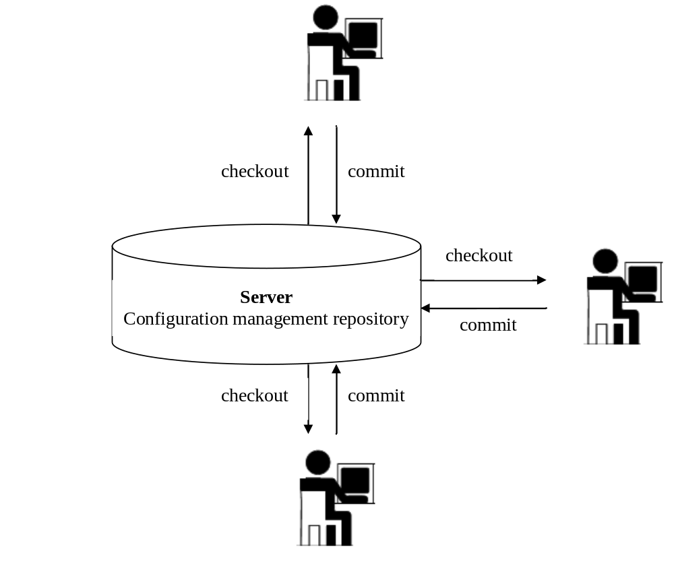
Check out and commit
A programmer checks out the latest version of file X
Makes all necessary changes
Then commits the modified file X to the repository
© 2012 Václav Rajlich, D. Hou Software Engineering: The Current Practice Ch. 3

Slide 16
Commit
The commit is usually done with a help of tool diff and merge
  diff produces a patch that identifies what changes the programmer made in the file by comparing the modified file X against the original file in the repository
  tool merge then merges the changes into the old file and thus creates a new file
© 2012 Václav Rajlich, D. Hou Software Engineering: The Current Practice Ch. 3

Slide 17
Diff and Merge
Diff produces a patch file that identifies what changes the programmer made in the file
  Compares the modified file X against the original file
Merge takes original file and a patch file
  merges the changes into the old file and thus creates a new file.
© 2012 Václav Rajlich, D. Hou Software Engineering: The Current Practice Ch. 3

Slide 18
Conflict
Programmer A and programmer B changed the same file X in parallel
Programmer A committed first
VCS does not allow B to commit
© 2012 Václav Rajlich, D. Hou Software Engineering: The Current Practice Ch. 3

Slide 19
Resolution of conflict
Programmer B
  checks out the version that was modified by programmer A and makes the changes in this modified file again
  Or: convinces programmer A to undo the changes which stand in the way of the changes done by programmer B
© 2012 Václav Rajlich Software Engineering: The Current Practice Ch. 3

Slide 20
Technology diffusion
Innovators
  the first group of users
  assume the risks
Early adopters
  draw on innovators’ experience
© 2012 Václav Rajlich Software Engineering: The Current Practice Ch. 3

Slide 21
Technology diffusion cont.
Majority adopters
  advantages are proven and well understood
  may take more than 10 years to reach this stage
Late adopters
  there is no longer any significant doubt
Laggards
  they have no other option
© 2012 Václav Rajlich Software Engineering: The Current Practice Ch. 3

Slide 22
Technology diffusion example
Automobile in Detroit
Innovators
  Henry Ford, others
Early adopters
  wealthy, purchase from innovators
Majority adopters
  model T made it accessible
Late adopters
  still used streetcars, but then saw benefits
Laggards
  streetcar tracks torn up, no other option
© 2012 Václav Rajlich Software Engineering: The Current Practice Ch. 3

Slide 23
Hype cycle
Peculiar behavior of innovators
Technology trigger
  product launch or other event generates significant interest
Inflated expectations
  a frenzy of publicity generates unrealistic expectations
Disillusionment
  technologies fail to meet expectations and become unfashionable
  normal diffusion resumes after disillusionment bottoms out
© 2012 Václav Rajlich Software Engineering: The Current Practice Ch. 3

Slide 24
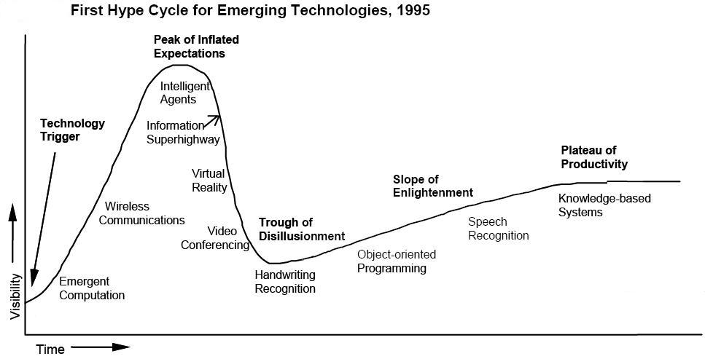
Hype cycle
J. Fenn, A. Linden. “Gartner’s Hype Cycle Special Report for 2005”. Gartner Research, Aug., 2005
© 2012 Václav Rajlich Software Engineering: The Current Practice Ch. 3

Slide 25
What language would we use if C/++ did not exist?
Python
Ruby
Swift
Husky
. . .
© 2012 Václav Rajlich Software Engineering: The Current Practice Ch. 3

